Slide 1
Real-time object detection with UAVs
Satyam Gaba
2015A8TS0469P

Slide 2
System Overview
RasPiCam
Raspberry Pi + Pi camera
Remote server (Titan V GPU)
Image transmission
Remote Access
(VNC Viewer)
Remote Access
(Jupyter Notebook)

Slide 3
RasPiCam
Has a multithreading environment
Image capture and storing
Transmission of stored image
Paramiko library for easy scp to the server
Mutex lock while write and reading the image file
Will be employed on the Drone

Slide 4
Remote Server
Retinanet with Resnet50 backbone.
Test_anchors.ipynb
Train.ipynb
Real-time detection.ipynb
Used Transfer learning on retinanet coco dataset with 80 object classes.
Used Aiskeye dataset. Manually removed scenarios which are not even nearly possible in testing:1480 training + 240 validation
Train 10 classes further for aerial images. (Overlapping classes were merged)
Regression- Smooth L1 loss
loss: 1.5639 - regression_loss: 1.2876 - classification_loss: 0.276
Classification- Focal loss
10 minutes per epoch.

Slide 5
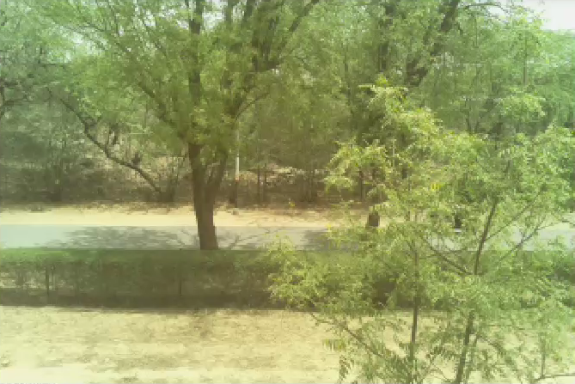
Demonstration

Slide 6
Limitations
Clearly, Image transmission to the remote server is the bottleneck here.
Image Resolution is inversely proportional to FPS and has significant effect on it.
Drone is in Arm stage, which is in ready to fly state. It topples while flying, mostly there is a problem in calibration
Due to heating, FPS decreases as the camera is functional for long time

Slide 7
Steps Ahead
Get the drone flying
Direct connection to the server, not through BITS network
Put RasPiCam on a drone and obtain the results
A powerful controller such as Beaglebone Black can be used
Model has to be improved by changing anchor parameters for the images at higher altitude

